Slide 1

Google App Engine Tutorial
Joe Gregorio
Developer Advocate
Google App Engine
Joe Gregorio
Developer Advocate
Google App Engine

Slide 2
Datastore
  Storing and Indexing Data

Slide 3
The Datastore
Entity store
Query Engine (GQL)
Transactions

Slide 4
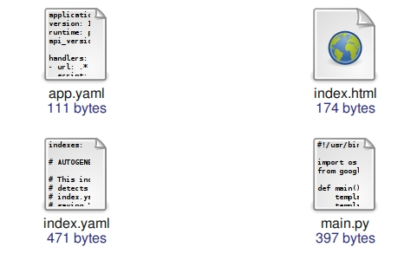
The contents of tutorial6

Slide 5
main.py
import os
from wsgiref.handlers import CGIHandler
from google.appengine.ext.webapp import template
from google.appengine.ext import db
class ToDoModel(db.Model):
description = db.StringProperty()
created = db.DateTimeProperty(auto_now_add=True)
class IndexHandler(webapp.RequestHandler):
def get(self):
todo = ToDoModel(description = "Hello World")
todo.put()
def main():
...

Slide 6
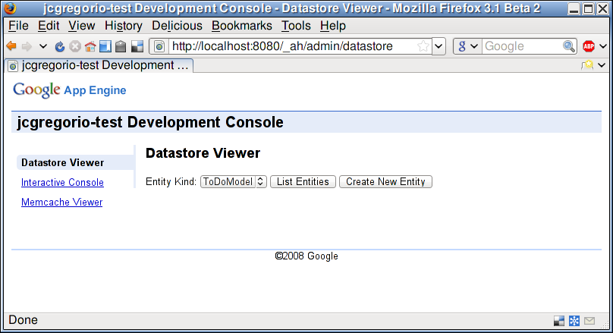
http://localhost:8080/_ah/admin

Slide 7
Datastore Viewer
Administrative Interface
Create/Edit/Delete Entities
Create only uses type information, no defaults, etc.
Note the 'ID' and 'Key'
You can provide your own key name

Slide 8
Add new properties to the model, see how they appear in the viewer
StringProperty
BooleanProperty
IntegerProperty
FloatProperty
DateTimeProperty
DateProperty
TimeProperty
ListProperty
StringListProperty
BlobProperty
TextProperty

Slide 9
tutorial7 – Actually add a web interface for creating items

Slide 10
Datastore Hints
dev_appserver.py -c

Slide 11
main.py
class ToDoModel(db.Model):
description = db.StringProperty()
created = db.DateTimeProperty(auto_now_add=True)
class IndexHandler(webapp.RequestHandler):
def get(self):
items = ToDoModel.all().order("-created").fetch(100)
template_values = {"items": items}
template_file = os.path.join(
os.path.dirname(__file__), "index.html")
self.response.out.write(template.render(
template_file, template_values))
def post(self):
description = self.request.get("description")
todo = ToDoModel(description = description)
todo.put()
self.redirect("/")

Slide 12
Query
class ToDoModel(db.Model):
description = db.StringProperty()
created = db.DateTimeProperty(auto_now_add=True)
class IndexHandler(webapp.RequestHandler):
def get(self):
items = ToDoModel.all().order("-created").fetch(100)
template_values = {"items": items}
template_file = os.path.join(
os.path.dirname(__file__), "index.html")
self.response.out.write(template.render(
template_file, template_values))
def post(self):
description = self.request.get("description")
todo = ToDoModel(description = description)
todo.put()
self.redirect("/")

Slide 13
Convenience method for query or POST arguments
class ToDoModel(db.Model):
description = db.StringProperty()
created = db.DateTimeProperty(auto_now_add=True)
class IndexHandler(webapp.RequestHandler):
def get(self):
items = ToDoModel.all().order("-created").fetch(100)
template_values = {"items": items}
template_file = os.path.join(
os.path.dirname(__file__), "index.html")
self.response.out.write(template.render(
template_file, template_values))
def post(self):
description = self.request.get("description")
todo = ToDoModel(description = description)
todo.put()
self.redirect("/")

Slide 14
index.html
<!DOCTYPE HTML>
<html>
<head>
<title> Hello World </title>
</head>
<body>
<ol>
{% for item in items %}
<li>{{ item.description }}</li>
{% endfor %}
</ol>
<form action="" method="post">
<p><label>To Do: <input type="text"
name="description" value="" /></p>
<p><input type="submit" value="Add" /></p>
</form>
</body>
</html>

Slide 15
Django Templating for-loop
<!DOCTYPE HTML>
<html>
<head>
<title> Hello World </title>
</head>
<body>
<ol>
{% for item in items %}
<li>{{ item.description }}</li>
{% endfor %}
</ol>
<form action="" method="post">
<p><label>To Do: <input type="text"
name="description" value="" /></p>
<p><input type="submit" value="Add" /></p>
</form>
</body>
</html>

Slide 16
Form for adding a new item
<!DOCTYPE HTML>
<html>
<head>
<title> Hello World </title>
</head>
<body>
<ol>
{% for item in items %}
<li>{{ item.description }}</li>
{% endfor %}
</ol>
<form action="" method="post">
<p><label>To Do: <input type="text"
name="description" value="" /></p>
<p><input type="submit" value="Add" /></p>
</form>
</body>
</html>

Slide 17
Datastore Viewer
Warnings about fetch()
Links to paging article
Create your own property types
References

Slide 18
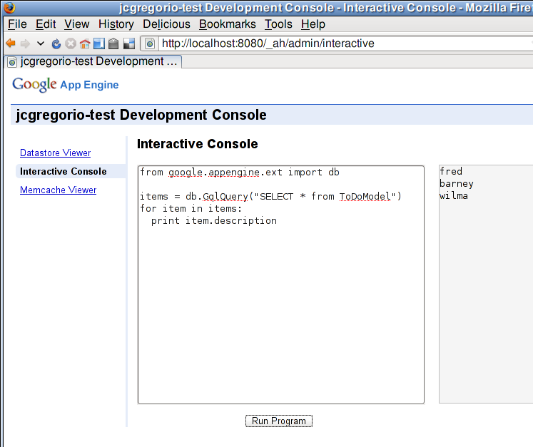
Interactive Console

Slide 19
Interactive Console
from google.appengine.ext import db
items = db.GqlQuery("SELECT * from ToDoModel")
for item in items:
print item.description

Slide 20
Queries
SELECT * from ToDoModel ORDER BY description
SELECT * from ToDoModel ORDER BY description DESC
SELECT * from ToDoModel WHERE description = :1
SELECT * from ToDoModel ORDER BY description, created DESC
print item.description, item.created, item.key(), item.key().id()

Slide 21
index.yaml
indexes:
# AUTOGENERATED
# Used once in query history.
- kind: ToDoModel
properties:
- name: description
- name: created
direction: desc

Slide 22
Indices
Ascending and Descending Indices for each property are created automatically
The development server adds entries to index.yaml
You can manually add indices
Indices take up space

Slide 23
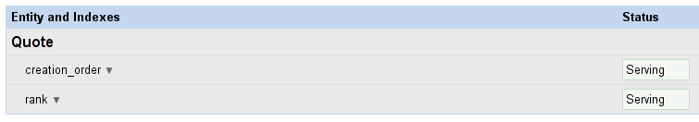
Datastore | Indexes

Slide 24
Practice
Print the 'id' of each entry
Provide a link using that 'id' to each entry
Advanced: Add a new input field to specify the key_name and use that key_name when creating the ToDoModel.

Slide 25
Transactions
Transactions
Counters

Slide 26
The contents of tutorial8

Slide 27
Keeping track of how many todo items have been created
class ToDoModel(db.Model):
description = db.StringProperty()
created = db.DateTimeProperty(auto_now_add=True)
class ItemCount(db.Model):
total = db.IntegerProperty(default=0)
Note: count() returns a maximum of 1000. If the actual number of entities that match the query criteria exceeds the maximum, count() returns a count of 1000.

Slide 28
Increment ItemCount.total
def post(self):
description = self.request.get("description")
todo = ToDoModel(description = description)
todo.put()
def txn():
count = ItemCount.get_by_key_name("created_items")
count.total += 1
count.put()
db.run_in_transaction(txn)
self.redirect("/")

Slide 29
Wrap the get and put inside a function
def post(self):
description = self.request.get("description")
todo = ToDoModel(description = description)
todo.put()
def txn():
count = ItemCount.get_by_key_name("created_items")
count.total += 1
count.put()
db.run_in_transaction(txn)
self.redirect("/")

Slide 30
Execute function inside a transaction
def post(self):
description = self.request.get("description")
todo = ToDoModel(description = description)
todo.put()
def txn():
count = ItemCount.get_by_key_name("created_items")
count.total += 1
count.put()
db.run_in_transaction(txn)
self.redirect("/")

Slide 31
Transactions
Only over a single entity or entity group
See the Sharding Counters Article

Slide 32
Thank You
  Questions?

